Slide 1
Presentation on
Personalised News Recommender
System

Slide 2

KAVIKULGURU INSTITUTE OF TECHNOLOGY AND SCIENCE
RAMTEK - 441106
DEPARTMENT OF COMPUTER TECHNOLOGY
Presented By:
Mr. Aditya Darne – CT20050
Ms. Sakshi Poshattiwar – CT20092
Ms. Vaishnavi Puttewar –CT20058
Ms. Janhvee Barai – CT20068
Ms. Sanskruti Yarwar – CT20038
Under the guidance of:
Ms. Ankita Nathe
(Assst. Professor)

Slide 3
Content
Introduction
Aim and Objectives
Patent
Literature Review
Proposed Approach and System Architecture
Implemented Work
Result and Discussion
Future Scope
Conclusion
10.References

Slide 4
Introduction
In the digital era, the volume of news and information available online has grown exponentially, leaving individuals overwhelmed and often struggling to find relevant and trustworthy news sources.
News recommendation system is designed to understand user preferences, analyze news content, and deliver personalized news recommendations in real-time.
The foundation of the system lies in understanding each user's preferences, interests, and reading habits.
An ML-driven NLP system continuously adapts and learns from user interactions. As users consume more news, the system refines its recommendations, ensuring that the content delivered is current and aligned with the user's evolving interests.

Slide 5
Aim
The aim of a news recommendation system using ML .It is used to generate personalized recommendations for each user, based on their interests, preferences, and historical behavior.
These systems use artificial intelligence techniques to analyze large amounts of data and make personalized recommendations.
The benefits of implementing a recommendation system include showing users newly-released content based on their preferences,profit margin, and improving customer satisfaction.

Slide 6
Objectives
1. To Personalization: Tailoring news content to individual user preferences, ensuring a more engaging and relevant news consumption experience.
2. To User Engagement: Increasing user interaction and time spent on the platform by delivering captivating and interesting news articles.
3.To Content Diversity: Balancing personalized recommendations with a diverse range of news topics to prevent filter bubbles and broaden users' perspectives.
4. To User Profiling: Develop a mechanism to create user profiles by analyzing their historical interactions with news

Slide 7
PRIOR ART
Sr. No. | Patent Application No. | Title of Patent | Existing Solutions (Abstract of Patent)
1 | US 9.489,112 B2 | Recommended News Edition on a Map Using Jio Entities | Described embodiments enable the presentation to a user of news articles or other content that is of likely interest to a user and that is geographically relevant to the user's location or region of interest.
2 | 202311019306 | Movie Recommendation System and Method Using Machine Learning | A method using Machine Learning Present invention discloses a system and method for recommending movie to user consisting of content based recommendation system to collect user’s data either by ratings or by collecting from the activities.

Slide 8
3. | US 9,542,649 B2 | Content Based Recommendation System | In one A media control system enables a device-agnostic and Source-agnostic entertainment experience through use of an internet-enabled user device.
4. | US 7,908,183 B2 | Recommendation System | A computer-implemented service analyzes purchase histories and/or other types of behavioral data of users on an aggregated basis to detect and quantify associations between particular items represented in an electronic catalog.

Slide 9
Literature reviews
Sr. No. | Tittle of paper | Details of publication with date and year | Literature identified for project
1 | Personalized News Recommendation Based on Click Behavior | 2020 | It would involve examining existing research on personalized news recommendations and how they utilize users' click behavior. Limitations might include issues with privacy, over-reliance on past behavior, and potential biases in the recommendation algorithm.
2 | News Recommendation Based on User Topic and Entity Preference in Historical Behavior | 2020 | It would involve exploring existing studies on news recommendation systems that leverage user preferences for topics and entities from their historical behavior. Limitations could encompass challenges in accurately capturing evolving user interests, potential information filter bubbles, and difficulties in handling sparse user data for effective recommendations.
3 | Wide and Deep Learning for Recommender Systems | 2019 | It would involve surveying existing research on the application of wide and deep learning techniques in recommender systems. Limitations may include the need for substantial computational resources, potential model complexity, and challenges in incorporating contextual information effectively for diverse recommendation scenarios.

Slide 10
4 | Research Progress of news Recommendation Methods | 2018 | It would involve surveying the current state of research on various news recommendation techniques. Limitations may encompass issues like the cold start problem, data sparsity, algorithm scalability, and challenges in incorporating user context and evolving preferences.
5 | Neural News Recommendation with Attentive Multi-View Learning | 2017 | It involves examining existing research on neural network-based news recommendation systems that leverage multi-view learning with attention mechanisms. Limitations may include the complexity of model architecture, potential challenges in training and parameter tuning, and difficulties in handling large-scale datasets.

Slide 11
Proposed Approach
To tackle privacy concerns in a personalized news recommender system, by considering the likes and dislikes of particular individual.
Enhance User Experience by tailoring news to individual interests, users are more likely to engage with and enjoy the content, leading to improved user satisfaction.
Personalization the Implement techniques like matrix factorization or neural networks to enhance personalization. Consider contextual information, such as location or time of day, for tailored recommendations.
Increase Engagement that Recommending news stories that align with a user's preferences can increase the likelihood of them spending more time on a news platform or website.

Slide 12
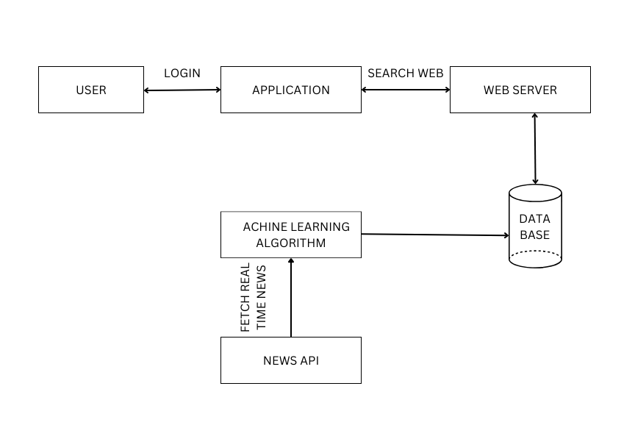
System Architecture
Fig.1: Flowchart Diagram of News Recommender System

Slide 13
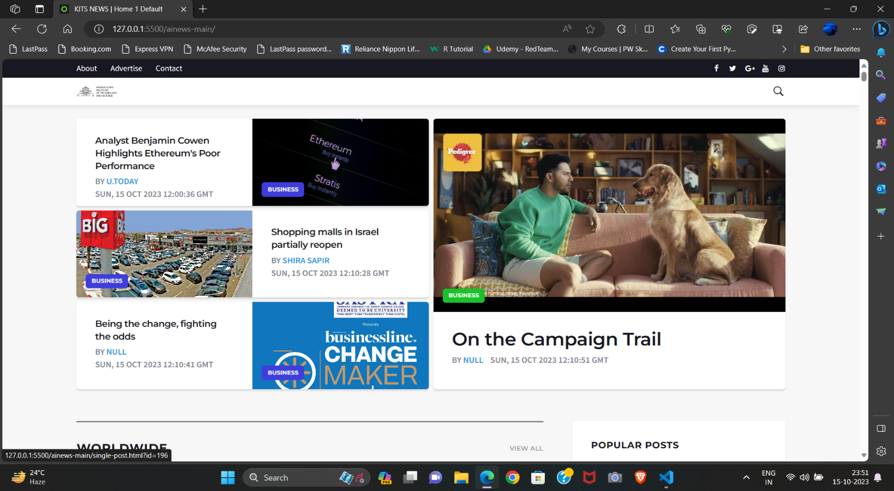
IMPLEMENTED WORK
Fig 2.1 Home Page
The home page of our News Recommendation System serves as the gateway to a personalized and informed news consumption experience.

Slide 14
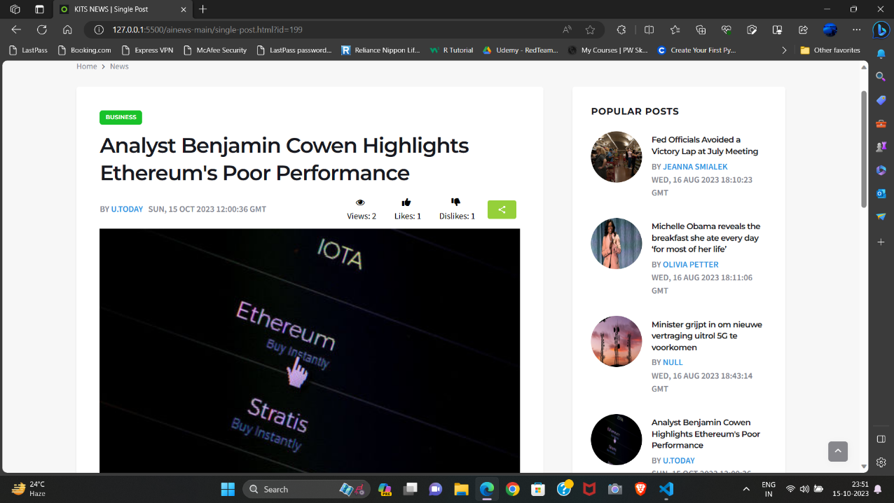
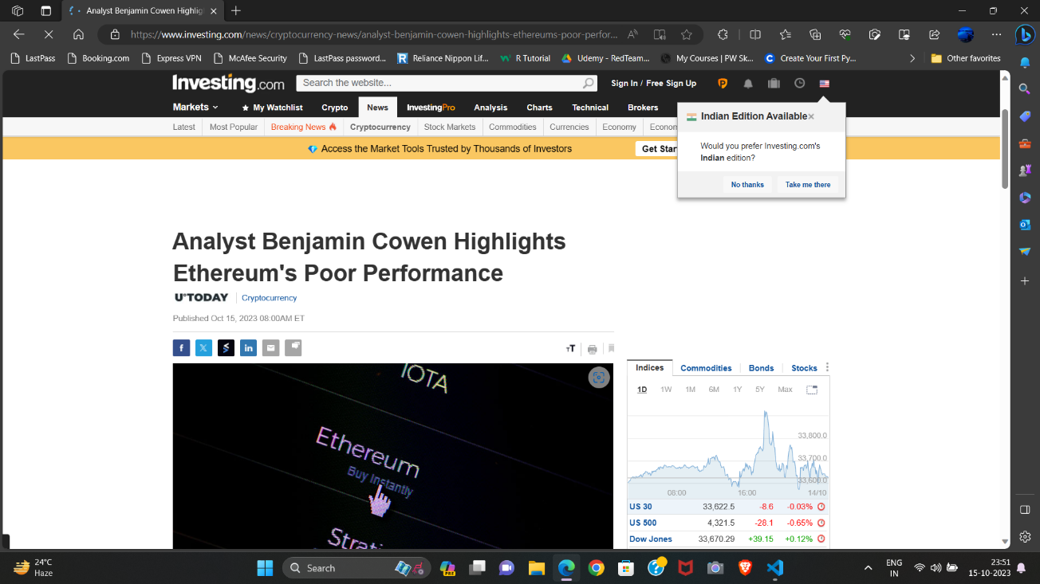
Fig 7.2 News Recommended
Fig 7.3 Redirected Page
The presented Figure illustrates the user interface of our sophisticated News a pivotal component of our project aimed at enhancing user engagement.
Mention the title of the redirected page. This could be the headline of the recommended news article. Provide details about the news source. Include the name of the website or platform from which the news is being recommended.

Slide 15
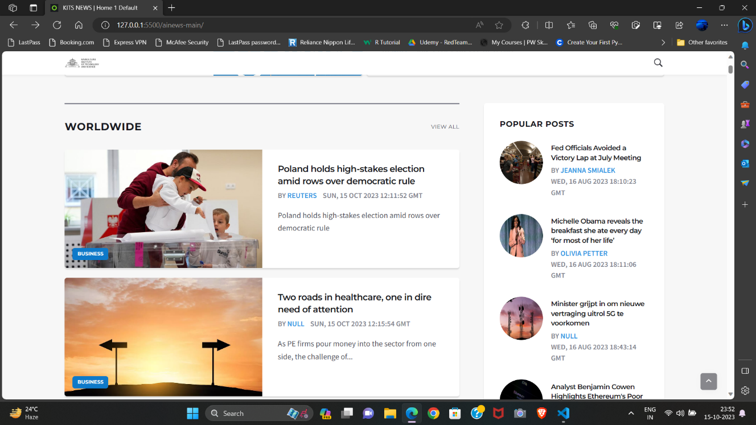
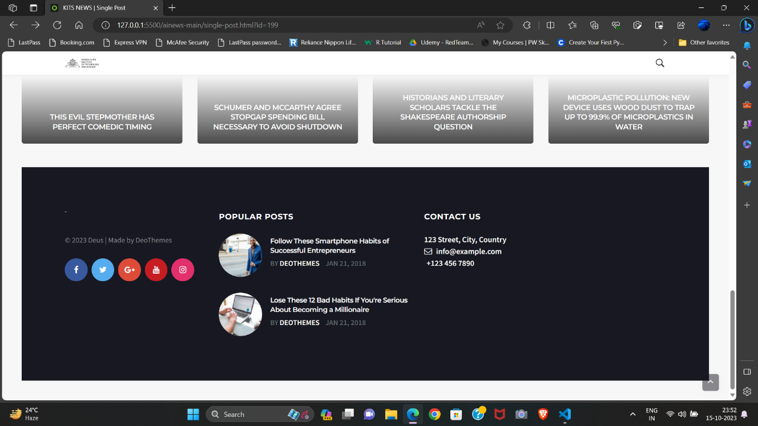
Fig 7.4 Worldwide News Section
Fig 7.5 Contact Us
The Worldwide News section serves as the global pulse of our News Recommendation System, encapsulating a diverse range of news stories from around the globe. This section is meticulously designed to provide users with a panoramic view of current events
The "Contact Us" section serves as a vital component within our News Recommendation System, providing users with a direct and efficient channel for communication. This feature is strategically designed to enhance user engagement

Slide 16
RESULT AND DISCUSSION
The implementation of a News Recommendation System utilizing Machine Learning (ML) for the front end has yielded promising results and triggered insightful discussions. Through the incorporation of ML algorithms, the system has successfully provided users with personalized news recommendations based on their preferences and historical interactions. The content-based filtering mechanism, driven by natural language processing and sentiment analysis, has proven effective in understanding user preferences and extracting key features for recommendation generation.
The user interface (UI) plays a pivotal role in enhancing the overall experience. The design focuses on simplicity, interactivity, and customization options, ensuring an intuitive and engaging platform for users. The recommendation models, employing both collaborative and content-based approaches, contribute to a more comprehensive and accurate suggestion system. The system's real-time updates keep users informed with the latest developments, and the incorporation of push notifications has significantly increased user engagement.

Slide 17
Future Scope
Data Collection and Preprocessing: Gather news articles from diverse sources.
Collect user interaction data (clicks, likes, shares, etc.).
Clean, preprocess, and store data for analysis.
User Profiling and Preference Modeling
Real-time Updates that Integrating real-time news updates and events into recommendation systems will ensure users receive the most up-to-date information.

Slide 18
Conclusion
It brings together a diverse set of tools and technologies to create a sophisticated platform for news recommendation. By combining data collection, preprocessing, analysis, and machine learning, the system aims to provide users with personalized and relevant news content.
The integration of web development technologies for the frontend and backend, along with advanced data analysis techniques, positions the project to deliver a seamless and tailored news consumption experience to users.
The utilization of NLTK and other Python libraries enhances the system's capabilities in text analysis and content recommendation. Overall, this project represents a significant step towards enhancing the way users consume and engage with news content in the digital age.

Slide 19
References
Billsus, D., & Pazzani, M. , "A hybrid user model for news story classification.“, 1999
Billsus, D., Pazzani, M. J., "User Modeling for Adaptive News Access", 2000
An, M.; Wu, F.; Wu, C.; Zhang, K.; Liu, Z.; Xie, X. "Neural news recommendation with long-and short-term user representations."2019.
Konstan, J.A.; Miller, B.N.; Maltz, D.; "Applying collaborative filtering to Usenetnews. Commun." 1997,
J. Duchi, E. Hazan, and Y. Singer., "Adaptive subgradient methods for online learning and stochastic optimization". 2011.

Slide 20
THANK YOU

